Slide 1
Introduction to Clustering
Linden Lu

Slide 2
Introduction to Clustering
K-means
DBSCAN
Case Study – Credit Card Data

Slide 3
Introduction to K-means Clustering
Linden Lu

Slide 4
Introduction to K-means Clustering
K-means
Choose k centers randomly
Form k groups by centers
Recalculate centers of k groups
Repeat 2–4 until no change in groups or reach max_iter
Calculate total distance D
Repeat 1–6 pre-defined times (n_init)
Choose groups with smallest D as final clusters

Slide 5
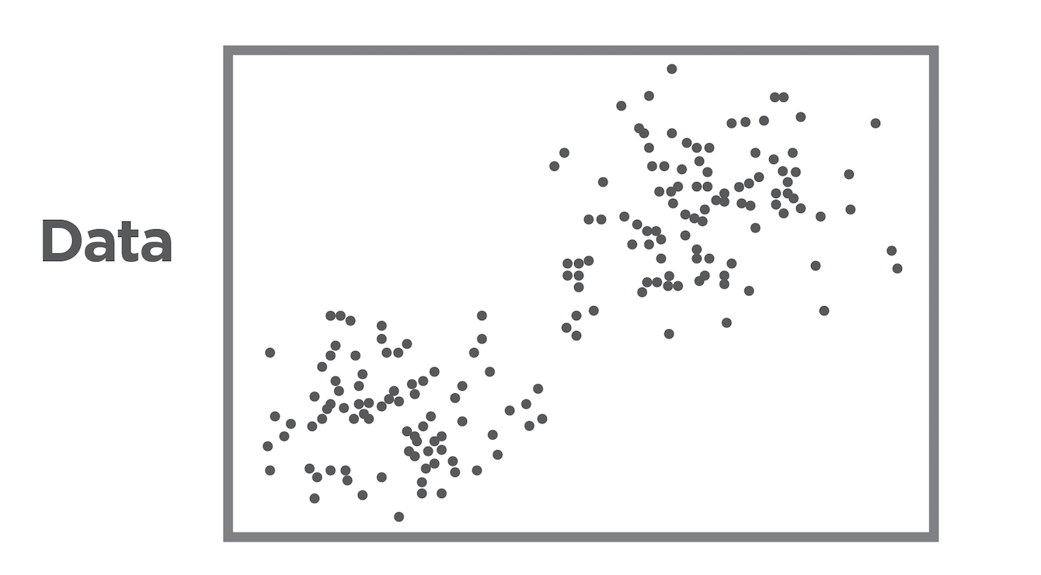
Introduction to K-means Clustering

Slide 6
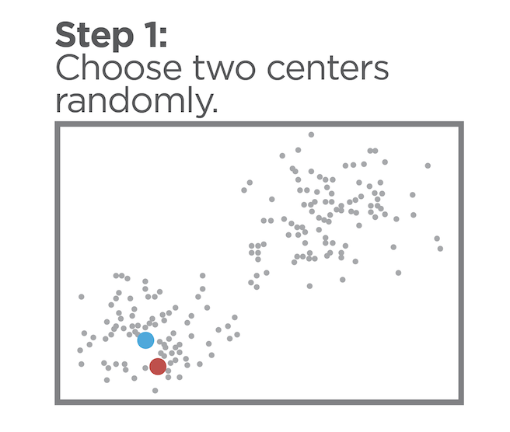

Slide 7
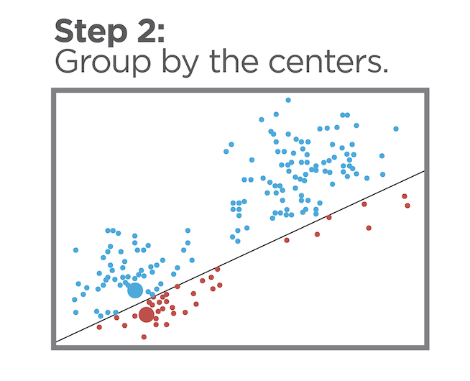

Slide 8
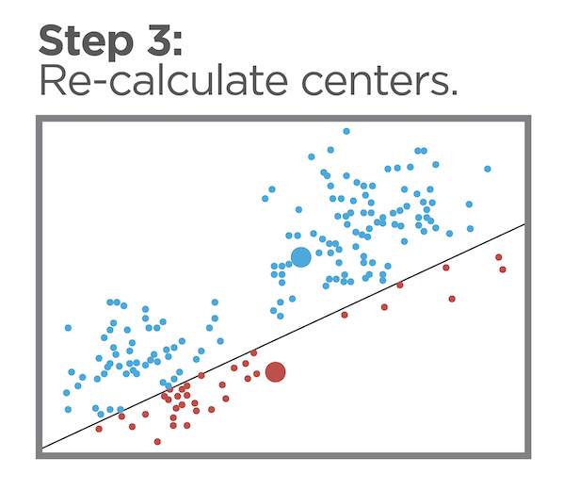

Slide 9
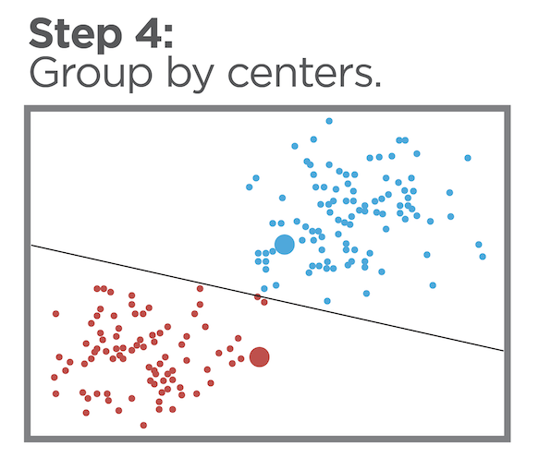

Slide 10
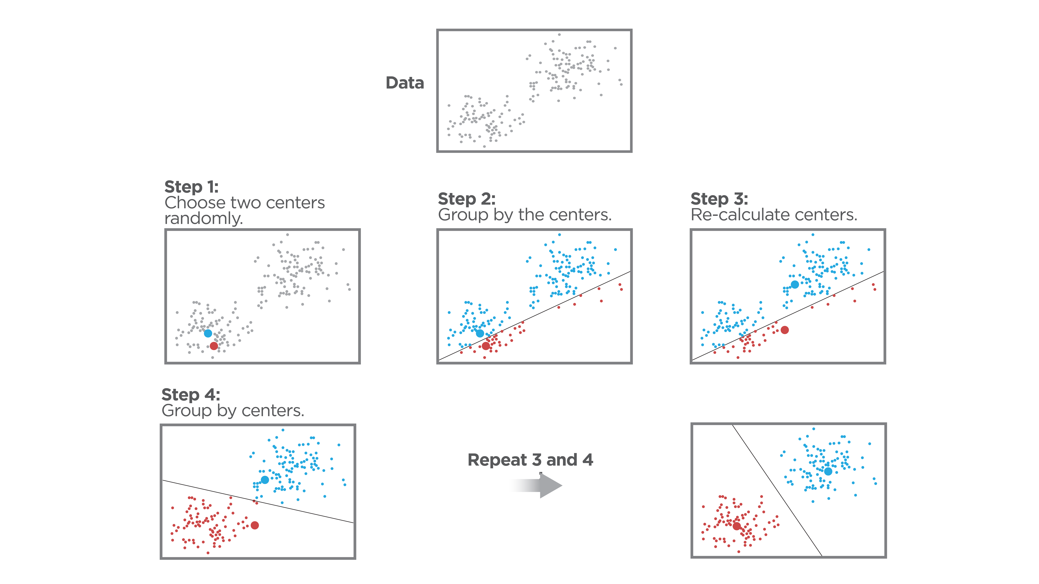
K-means (k=2)

Slide 11
Iris Dataset
 | sepal_length | sepal_width | petal_length | petal_width
25 | 5.0 | 3.0 | 1.6 | 0.2
127 | 6.1 | 3.0 | 4.9 | 1.8
16 | 5.4 | 3.9 | 1.3 | 0.4
105 | 7.6 | 3.0 | 6.6 | 2.1
102 | 7.1 | 3.0 | 5.9 | 2.1

Slide 12
Principal Component Analysis (PCA)
Reduces dimension
Retains major characteristics of original features
Helps visualize clusters

Slide 13
Scikit Learn K-means Model
Scale features
No train-test split
Hyperparameters
n_clusters: number of clusters, 𝑘
n_init: number of times to choose different initial centers, default 10
max_iter: maximum number of iterations for the algorithm in any given run, default 300
random_state: random seed, enables reproducibility

Slide 14
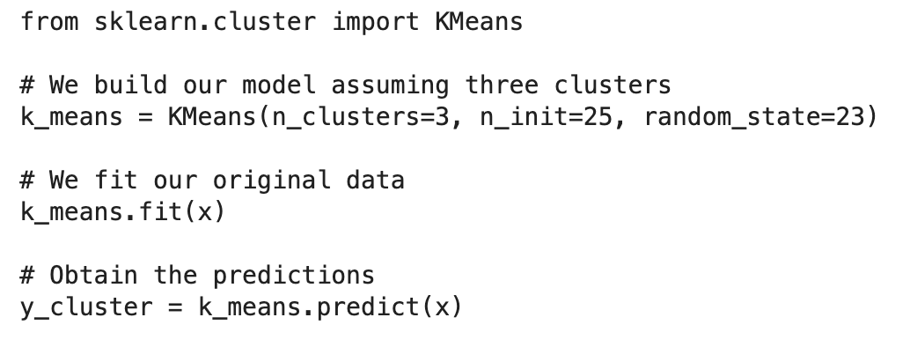
Scikit Learn K-means Model

Slide 15
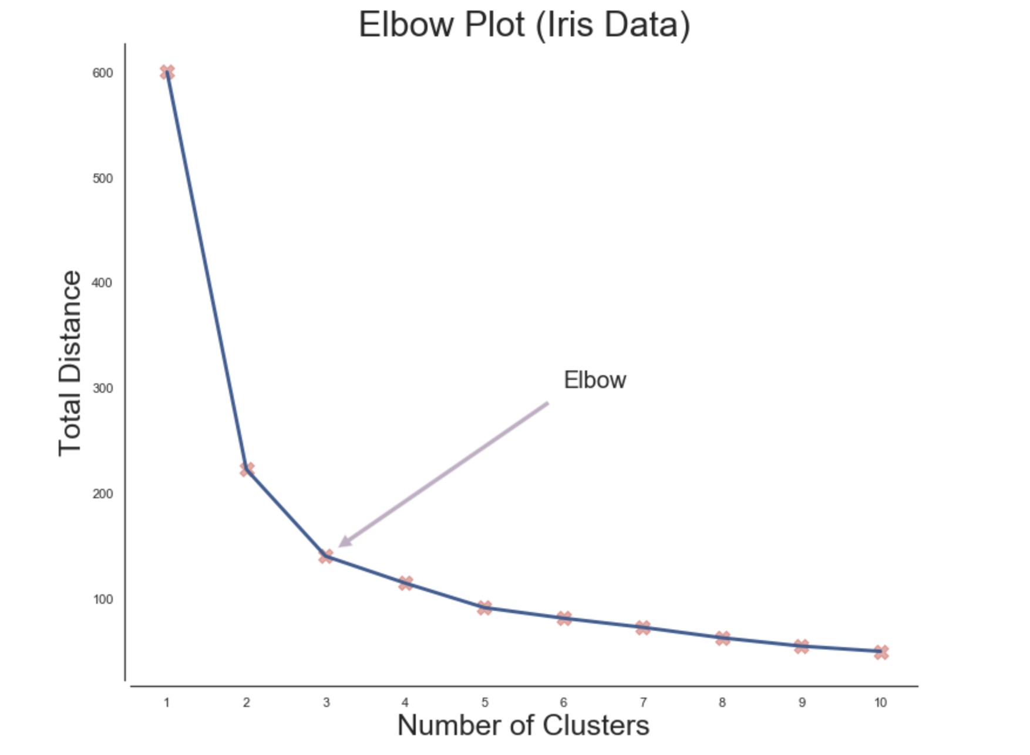
Determine K: Elbow Method

Slide 16
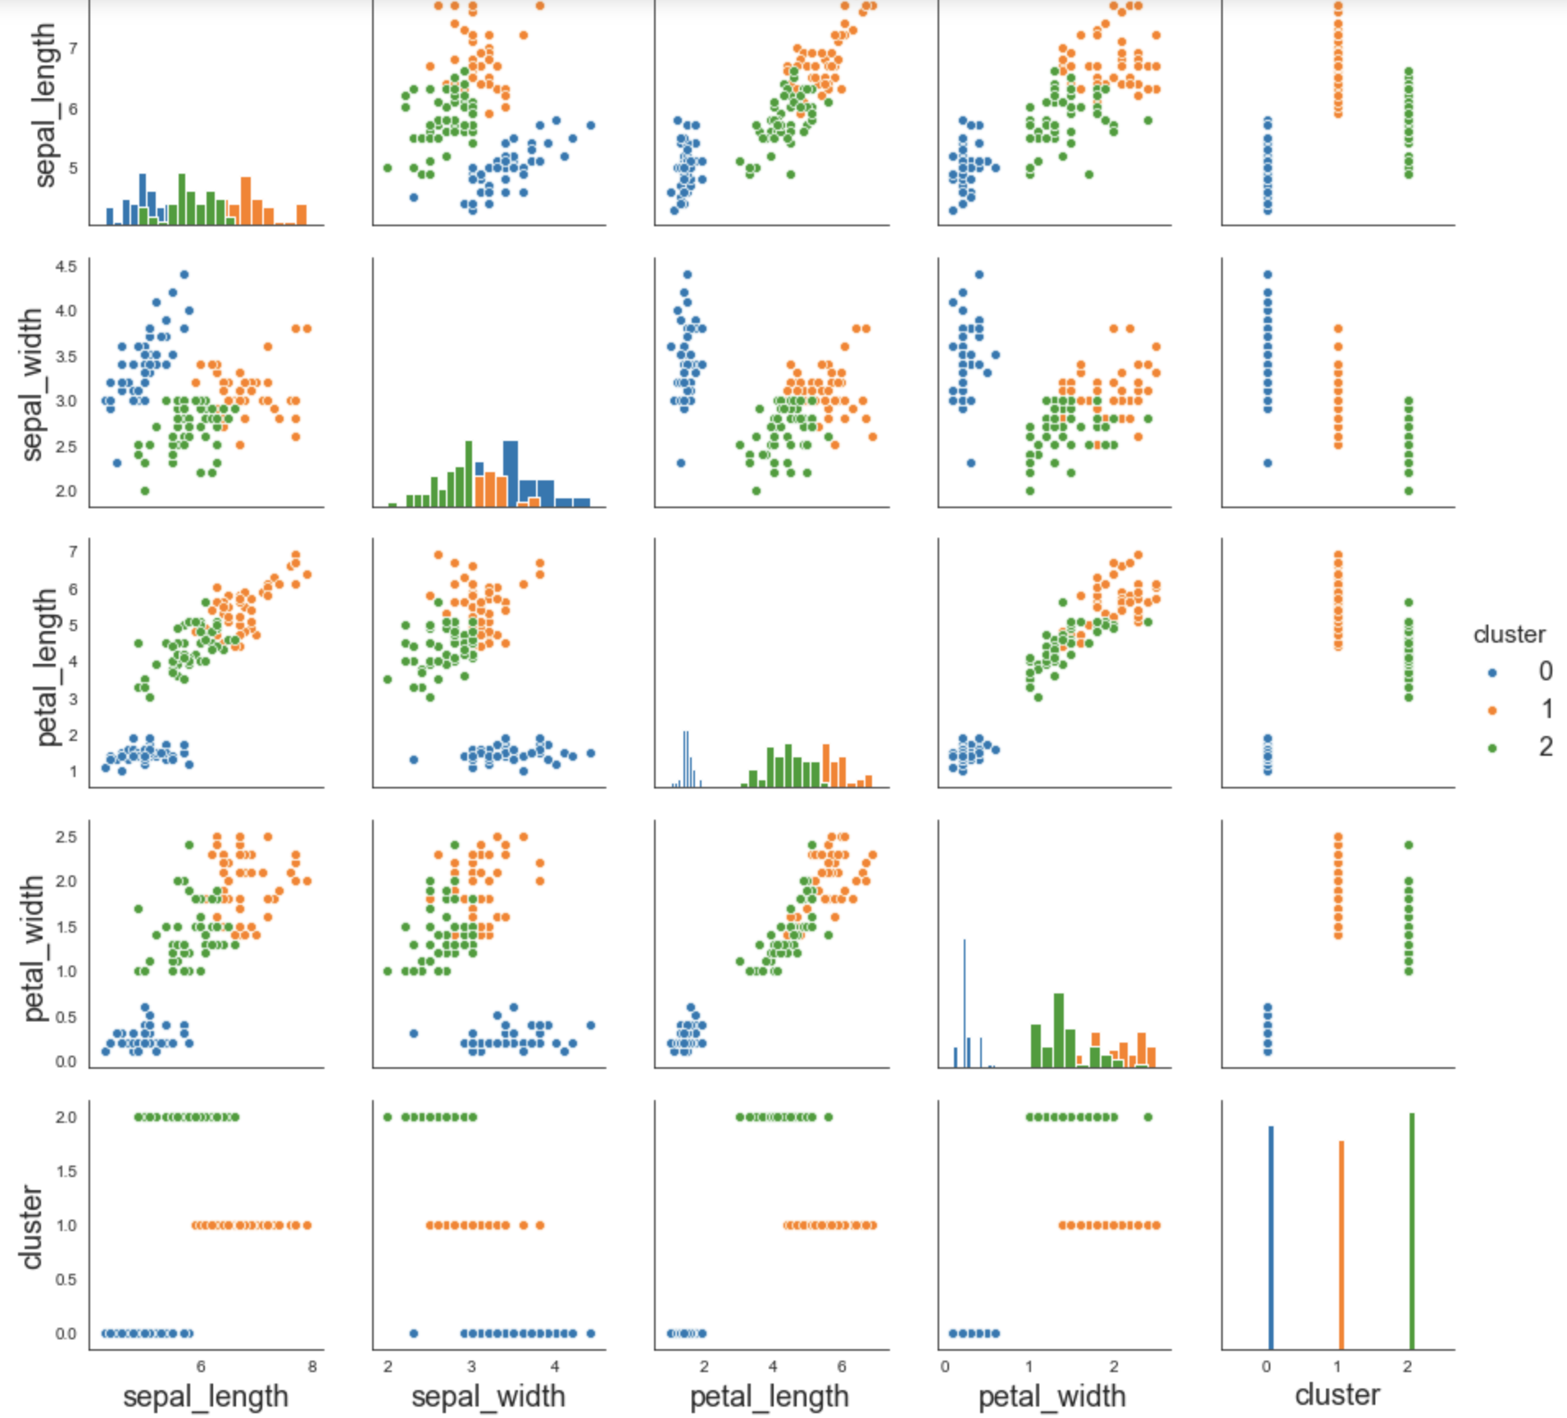
Explore Cluster Characteristics

Slide 17
Cluster Evaluation
Adjusted Rand Index
-1 to 1
Compare with true class
Silhouette
-1 to 1
Don't use true class
Compare distance to assigned center and next closest center

Slide 18
K-means Case Study
Linden Lu

Slide 19
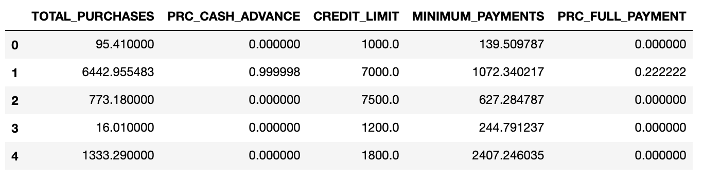
K-means Case Study
Credit Card Dataset

Slide 20
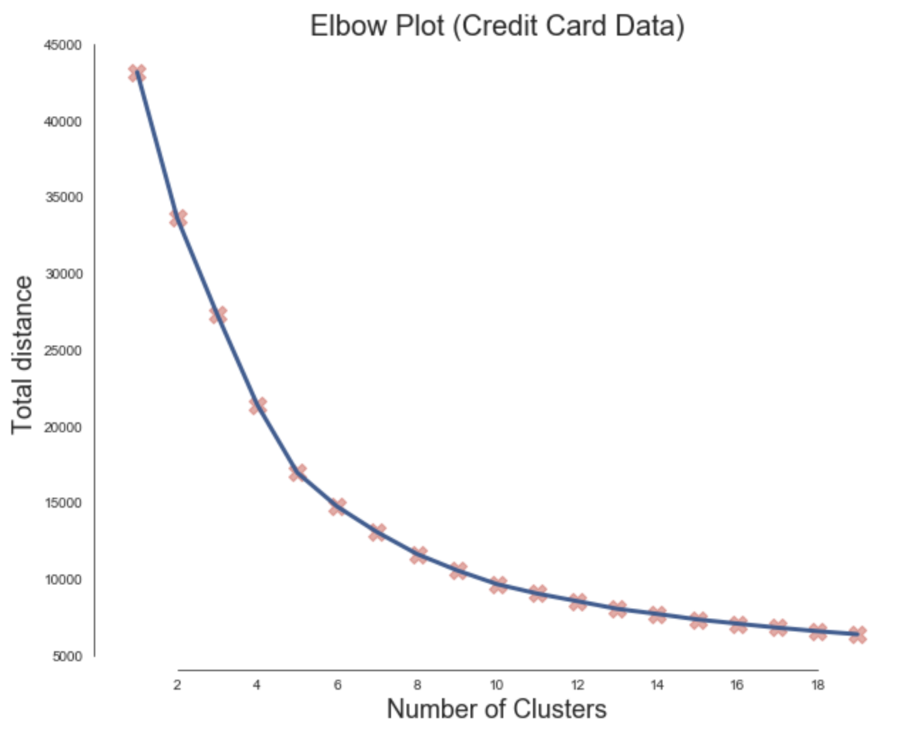
Determine K

Slide 21
Cluster Member Counts
Cluster 0 : 3436 members
Cluster 1 : 2572 members
Cluster 2 : 1270 members
Cluster 3 : 1233 members
Cluster 4 : 56 members
Cluster 5 : 69 members

Slide 22
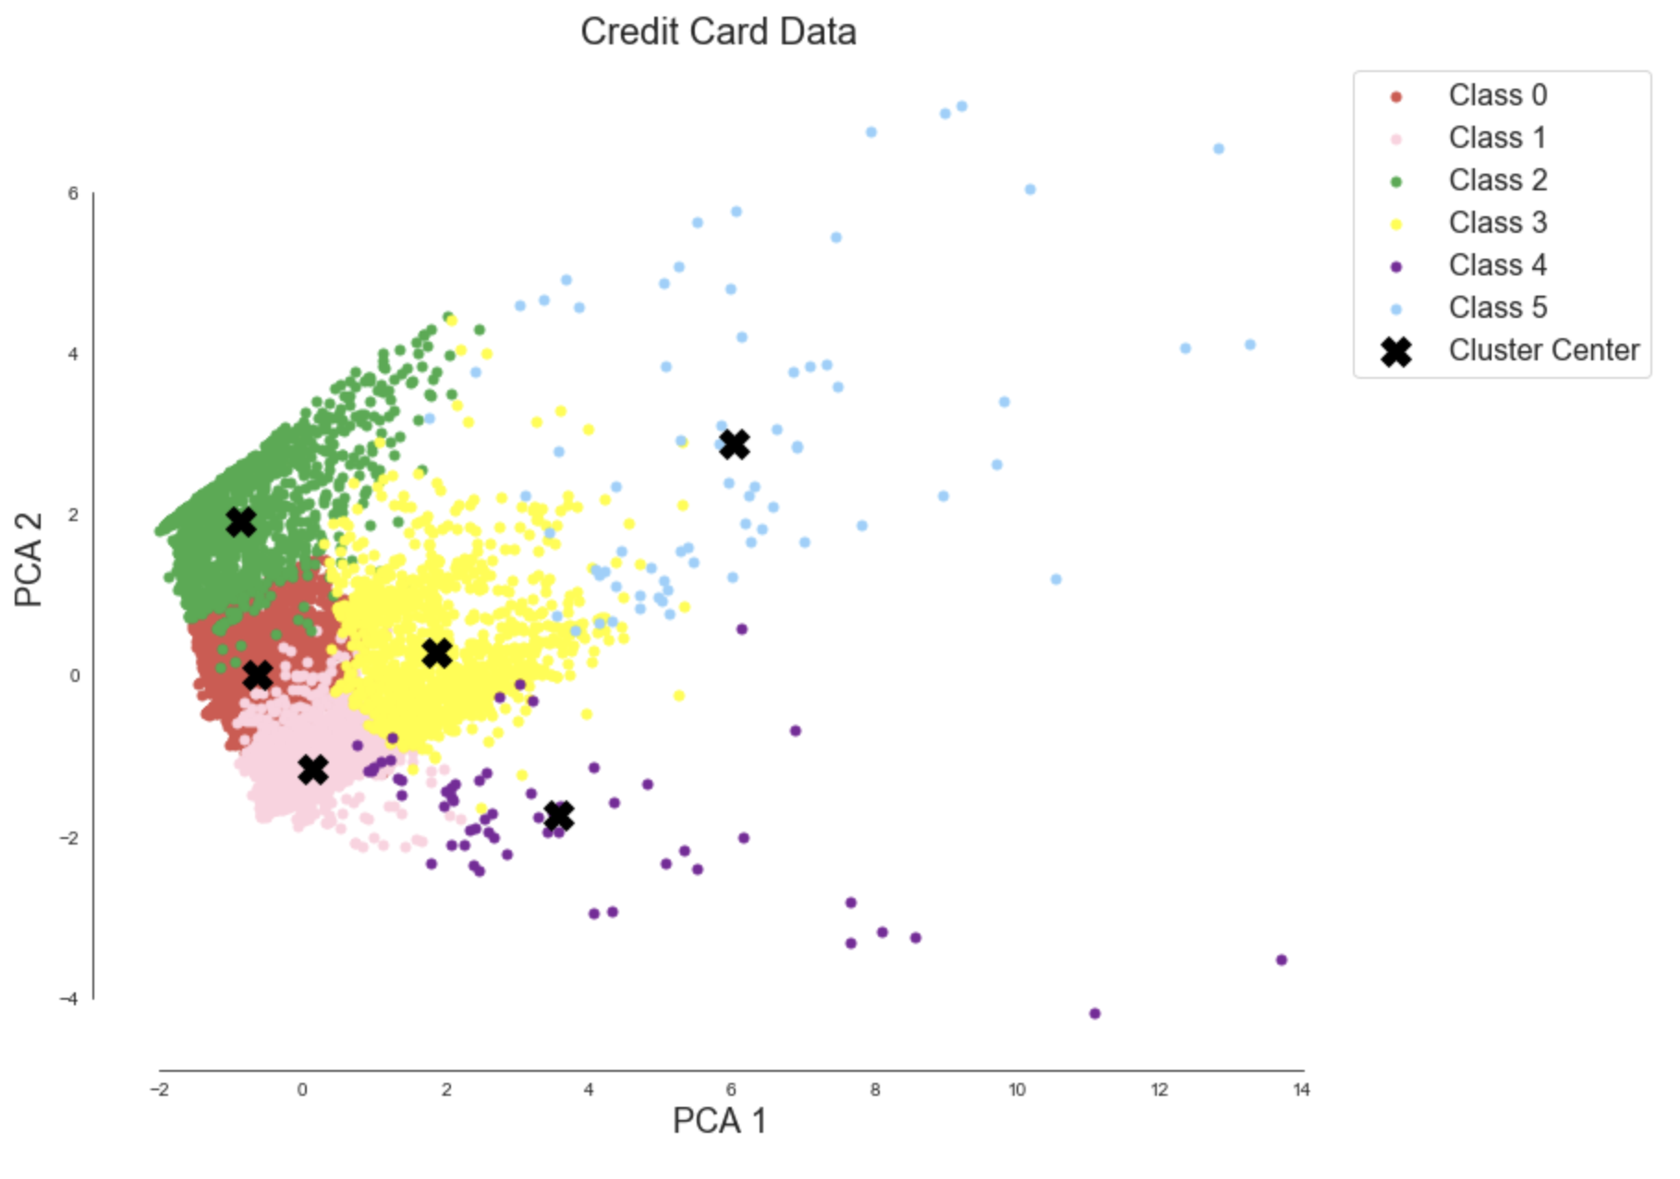
Visualize Data

Slide 23
Introduction to Density–Based Clustering
Linden Lu

Slide 24
DBSCAN
Hyperparameters
eps: Max distance between two points to be considered as in same neighbor
min_samples: Number of points that must lie within the neighborhood of the current point in order for it to be considered a core point
Point Categories
Core point: At least min_samples of points within distance eps
Border point: A core point, but within eps to at least one core point
Noise point: Neither core point nor border point
Clusters
All core points that are reachable to each other form a cluster. All border points of these core points also belong to the cluster.

Slide 25
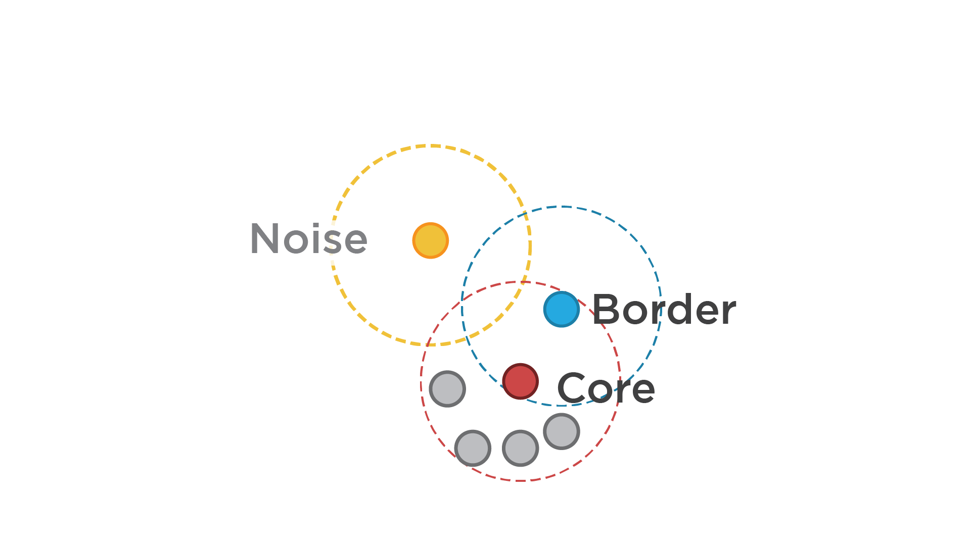
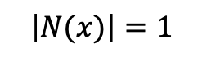
$$\left|N(x)\right|=1$$
minpts = 4

Slide 26
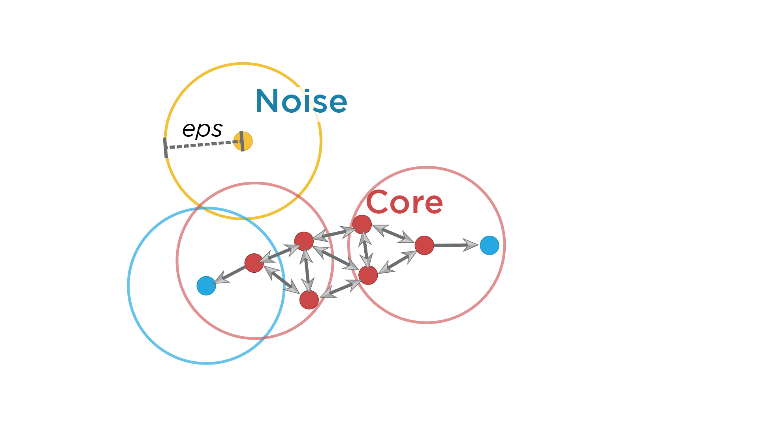
MinPts = 4
Red: Core points
Yellow: Border points. Still part of the cluster because it’s within epsilon of a core point, but does not meet the min_points criteria.
Blue: Noise point. Not assigned to a cluster.

Slide 27
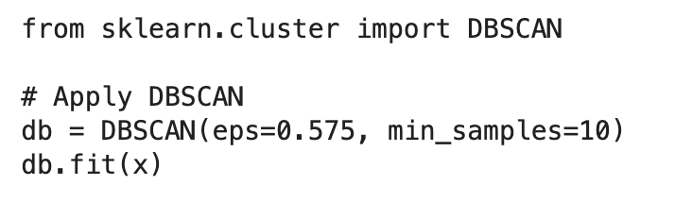
Scikit Learn DBSCAN Model

Slide 28
Hyperparameter Estimation
min_samples
Greater than number of features, i.e., 2 times
eps
Small eps preferable
K-distance graph

Slide 29
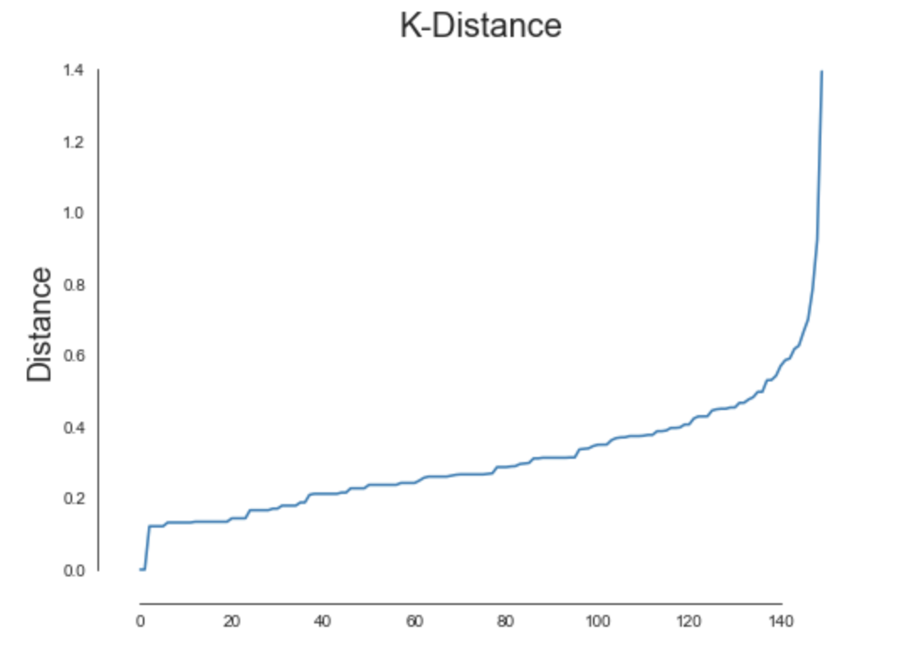
K-distance Graph
Plot distance to nearest neighbor for all data points.
Choose a distance at elbow that covers majority of data points.

Slide 30
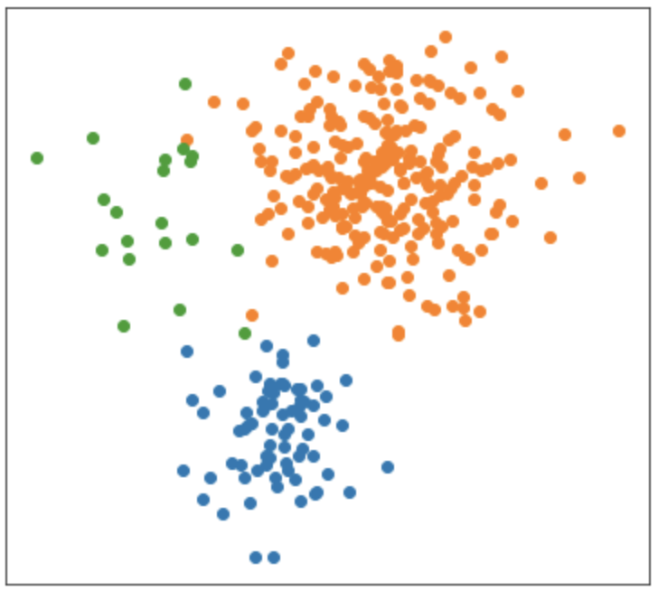
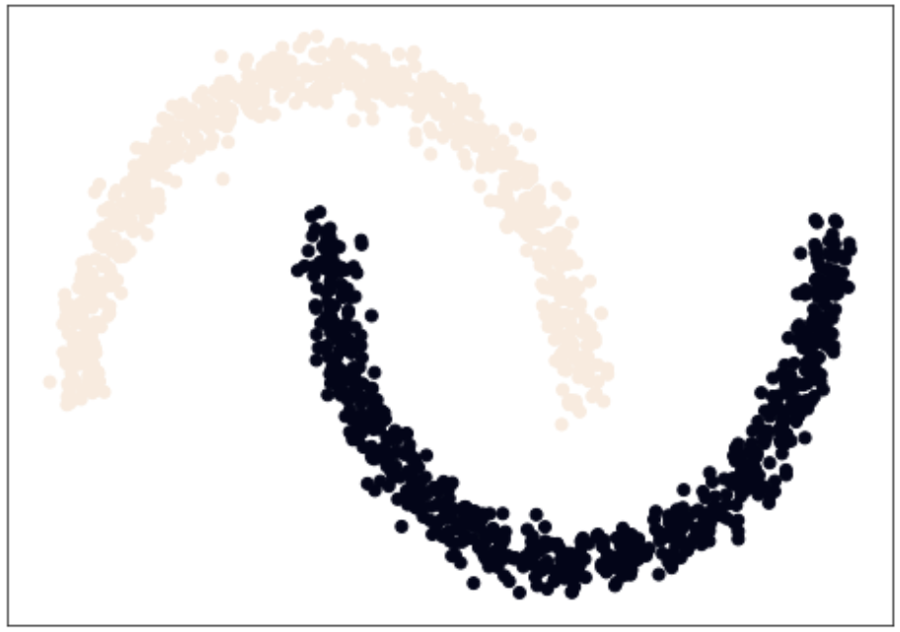
K-means vs. DBSCAN
K-means works well.
K-means works poorly, but DBSCAN works well.

Slide 31
Credit Card Data Visualization

